Slide 1


Santa Rosa
Student Attendance Monitoring System for the Tertiary Department of STI College Santa Rosa
Prepared and Presented by:
Alexander P. Saga
Jan Amiel M. Arceo
Mitch A. Serrano

Slide 2
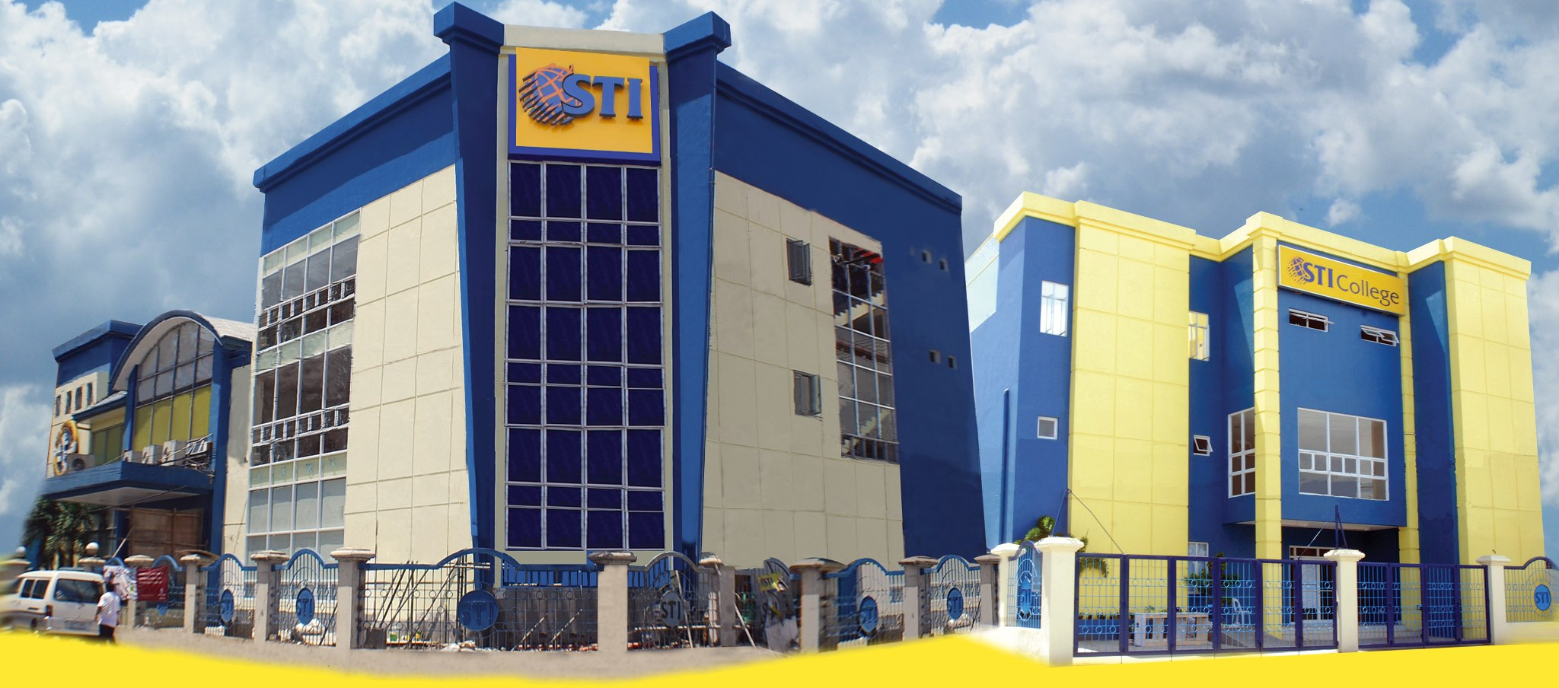
ABOUT THE CLIENT
STI College Santa Rosa, located at Francisco Canicosa Ave., Barangay Balibago, Santa Rosa, Laguna is a university that offers SHS and College programs.

Slide 3


STI College Santa Rosa Tertiary Department used to have a Mobile application for Monitoring Student Attendance but due to many issues and limitations of the system, STI College Professors switch back to using Manual Attendance Gathering.
Santa Rosa

Slide 4
IMPORTANCE OF HAVING A STUDENT ATTENDANCE MONITORING SYSTEM
TRACK STUDENT PERFORMANCE IN CLASS
AUTO-GENERATE VARIOUS TYPES OF REPORTS OF CLASS OR STUDENT ATTENDANCE
REAL-TIME STATUS TRACKING
REDUCE PAPERWORK AND SAVE TIME

Slide 5
STATEMENT OF THE PROBLEM
A student attendance is not thoroughly monitored.
Concerned departments does not receive attendance report in real-time.
RFID Embedded ID is not observed in the Tertiary Department. Raises school security concern.

Slide 6

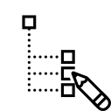
PURPOSE AND DESCRIPTION OF THE STUDY
Improve the current Student Attendance Monitoring System in STI College Santa Rosa.
Identify and Address issues with the current Student Attendance Monitoring System in STI College Santa Rosa.

Slide 7







OBJECTIVES OF THE STUDY
General Objective:
To develop a web application to improve the current Attendance Monitoring System in STI College Santa Rosa’s Tertiary Department.
Specific Objective:
To create a Student Attendance Monitoring System that integrates devices used for monitoring attendance within STI College Santa Rosa.
To create a Student Attendance Monitoring System to add another layer of security.
To create a Student Attendance Monitoring System that generates attendance reports.

Slide 8
SIGNIFICANCE OF THE STUDY
The main beneficiary of this study was the management of STI College Santa Rosa. This study shall tackle issues within the campus and how those issues can be addressed.
The proposed system by the proponents shall help the faculty and the admin staff of STI College Santa Rosa to track their student attendance with ease and convenience.
For students enrolled in STI College Santa Rosa, this study tackles security issues in the campus to protect the campus and its students.
For the researchers, this study will help them gain new knowledge and experience relevant to their profession.

Slide 9


SYSTEM PROPOSAL
BENEFITS OF A WEB-APPLICATION
Maximum Compatibility
Flexible
Wide-range access
Real-time
Easy Device Integration
WEB-APPLICATION

Slide 10





SYSTEM PROPOSAL
Desktop
Iphone
Laptop
RFID Device
Android

Slide 11



SYSTEM PROPOSAL
SYSTEM FEATURES
Automatic Report Generation
Multiple user accounts and privileges
Realtime Database

Slide 12


SYSTEM PROPOSAL
LIMITATIONS
Application requires internet access to use.
Only users with account in the system can use its service.

Slide 13
End of Presentation. Thank you.

